Slide 1
Escape Room Wireframes

Slide 2
Puzzle 1
Player will be given a suitcase containing a broken watch, VIP pass, credit card, gift card, song lyrics and introduction paper. They will need to manipulate the song lyric paper or read between the lines to find out they actually need to peel the bottom off the velcro and reveal a frame.
This frame will be placed over the passes to reveal a colored number which will be put into a colored lock.

Slide 3
Puzzle 2
The colored lock opens and the player is rewarded with a blacklight, vigenere cypher, maze, tinyURL to a youtube video, and half security image.
The youtube video has an agent

Slide 4
Puzzle 3
Player is given the paper with half a security image and a tiny url link to a youtube video. Here they are congratulated for their progress and are instructed to match up security footage to reveal the next tiny url link to the website.
Players are also given a black light.

Slide 5
Puzzle 4
Players need to decrypt the vigenere cypher to get the password hint. Which would be something along the lines of rhombussquaretriangle
Players have been given symbols throughout the game that seemed like red herrings. They now are given a clue as a password hint which required them to put things together from the previous puzzles.

Slide 6
Video Puzzle

Slide 7
Puzzle
Fake desktop hosted on github. Click through different icons to find the next clue.
Concept:
Passwords
Receipts
Work

Slide 8
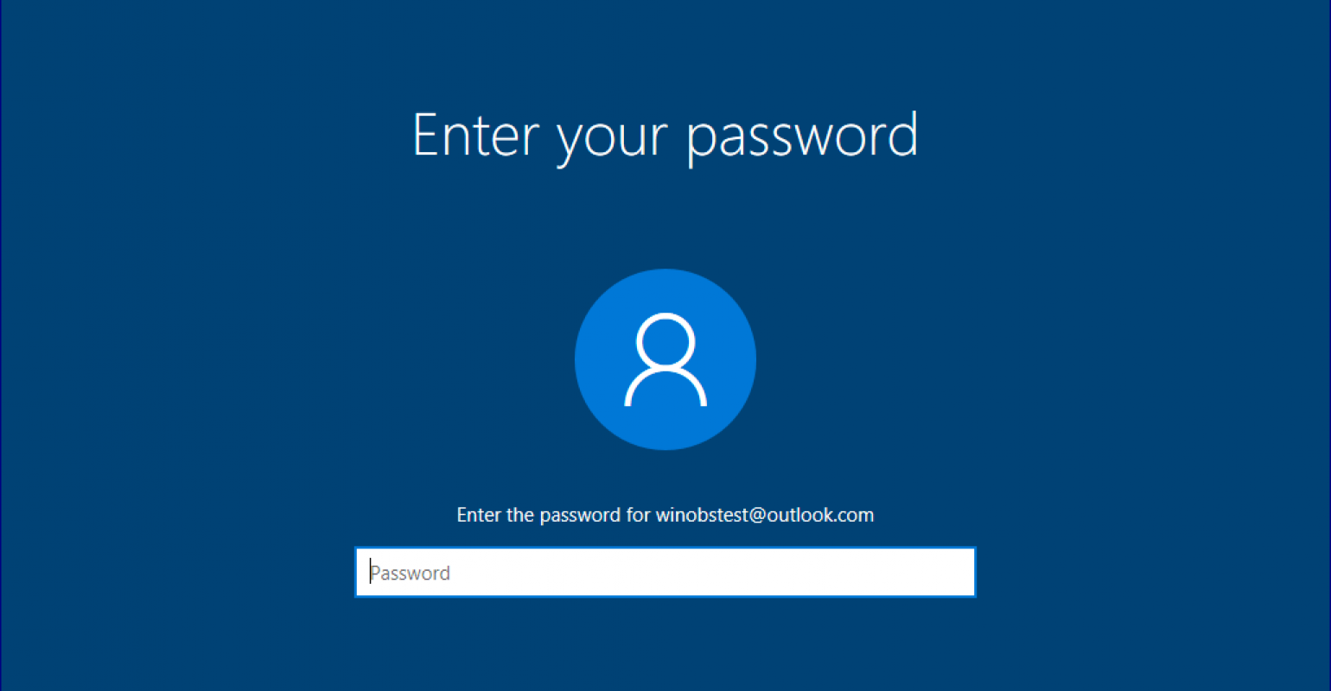
Puzzle
Guess the password to get into the desktop
This puzzle would be accessed from a website that we would create. The password will be “Password”.
This is a text input

Slide 9
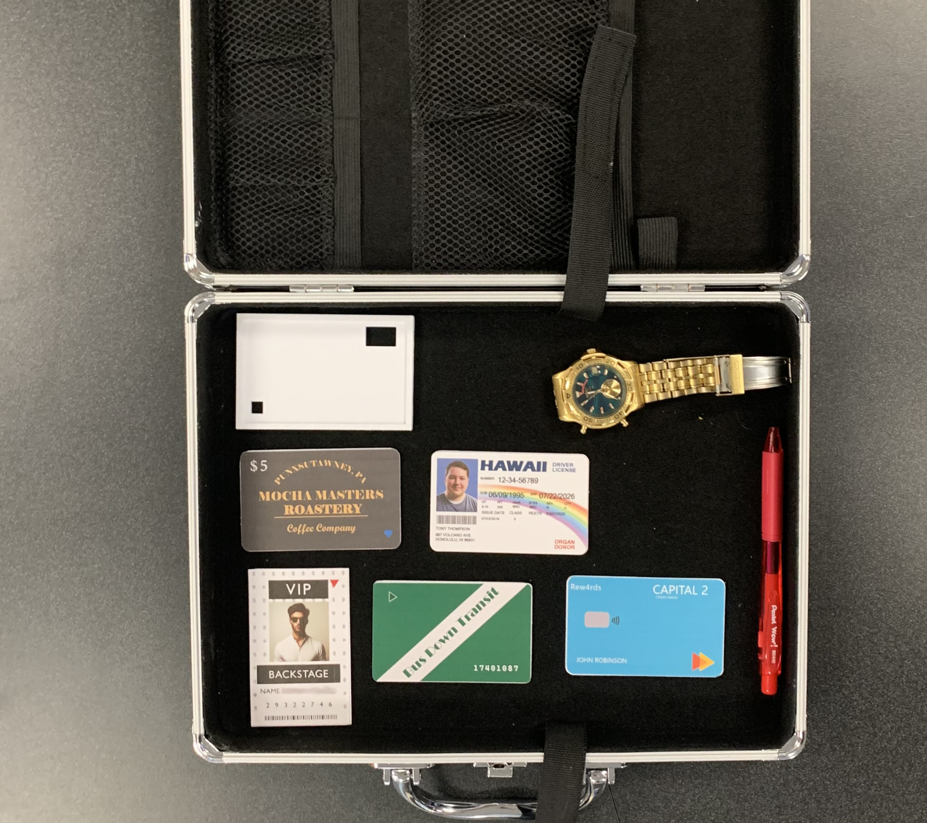
Card Reader Frame
Broken Watch
Mocha Masters Gift Card
Hawaii ID Card
Capital Two Credit
VIP Pass Card
Bus Card

Slide 10
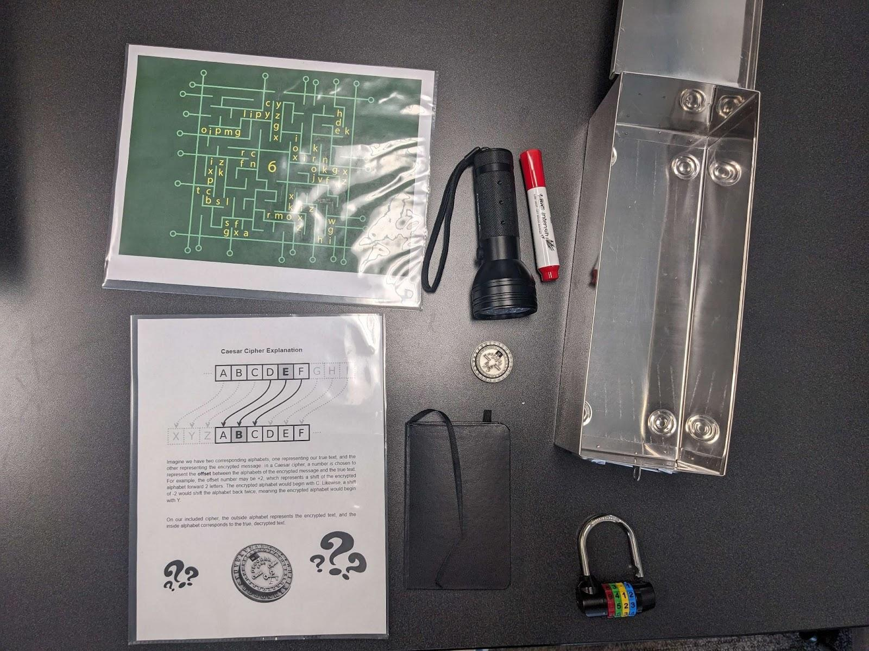
Circuit Board Maze
Blacklight
Caesar Cipher Decoder
Decoder Tutorial Sheet
Journal

Slide 11
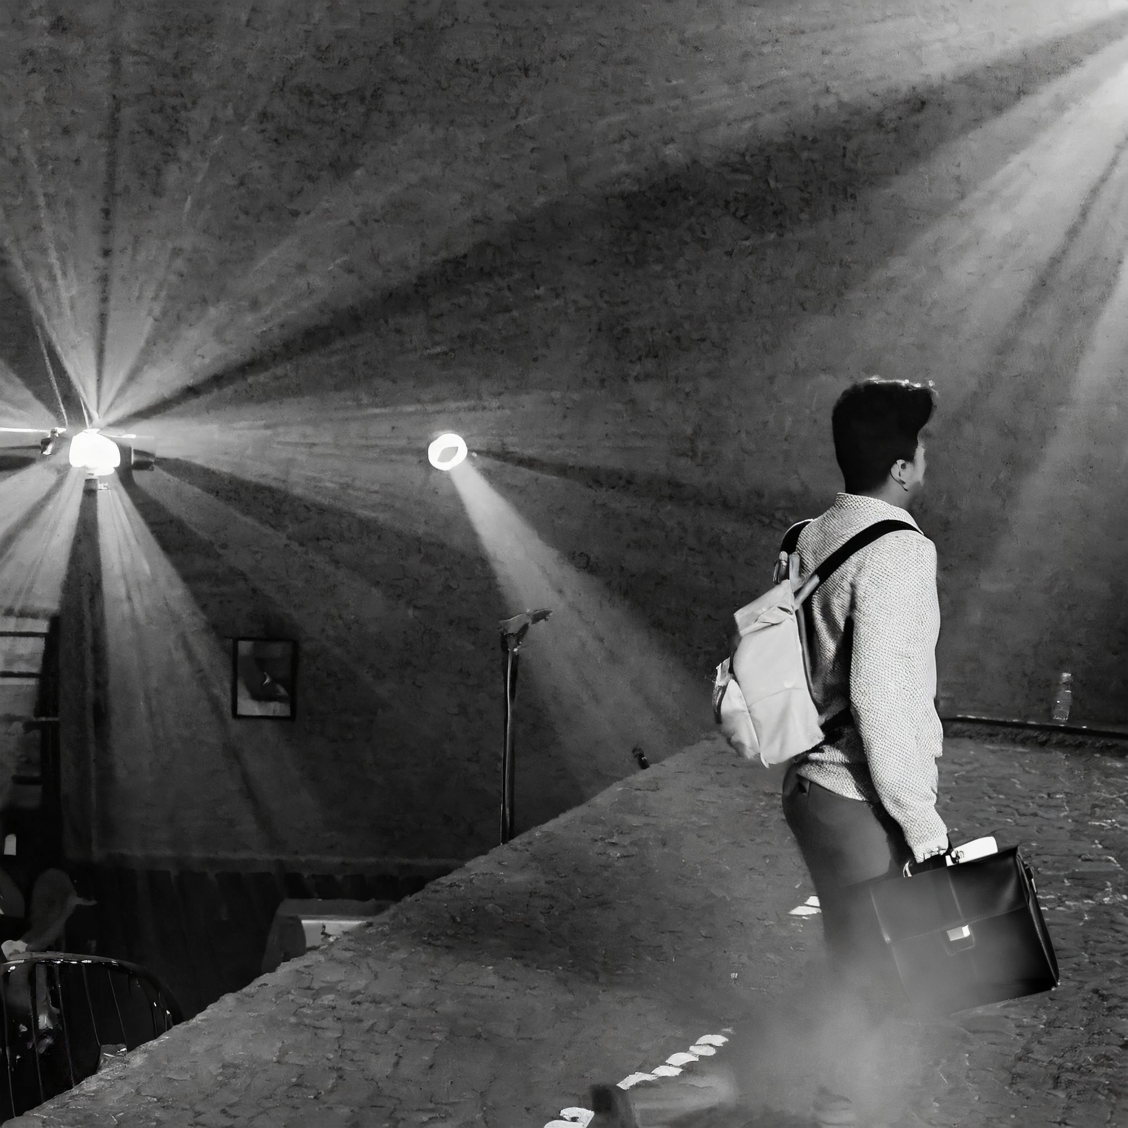
Use time on watch to match the footage
INSERT IVOPMLO
INSERT IV9ijK2LO
INSERT INCOMPL
ETE URL

Slide 12
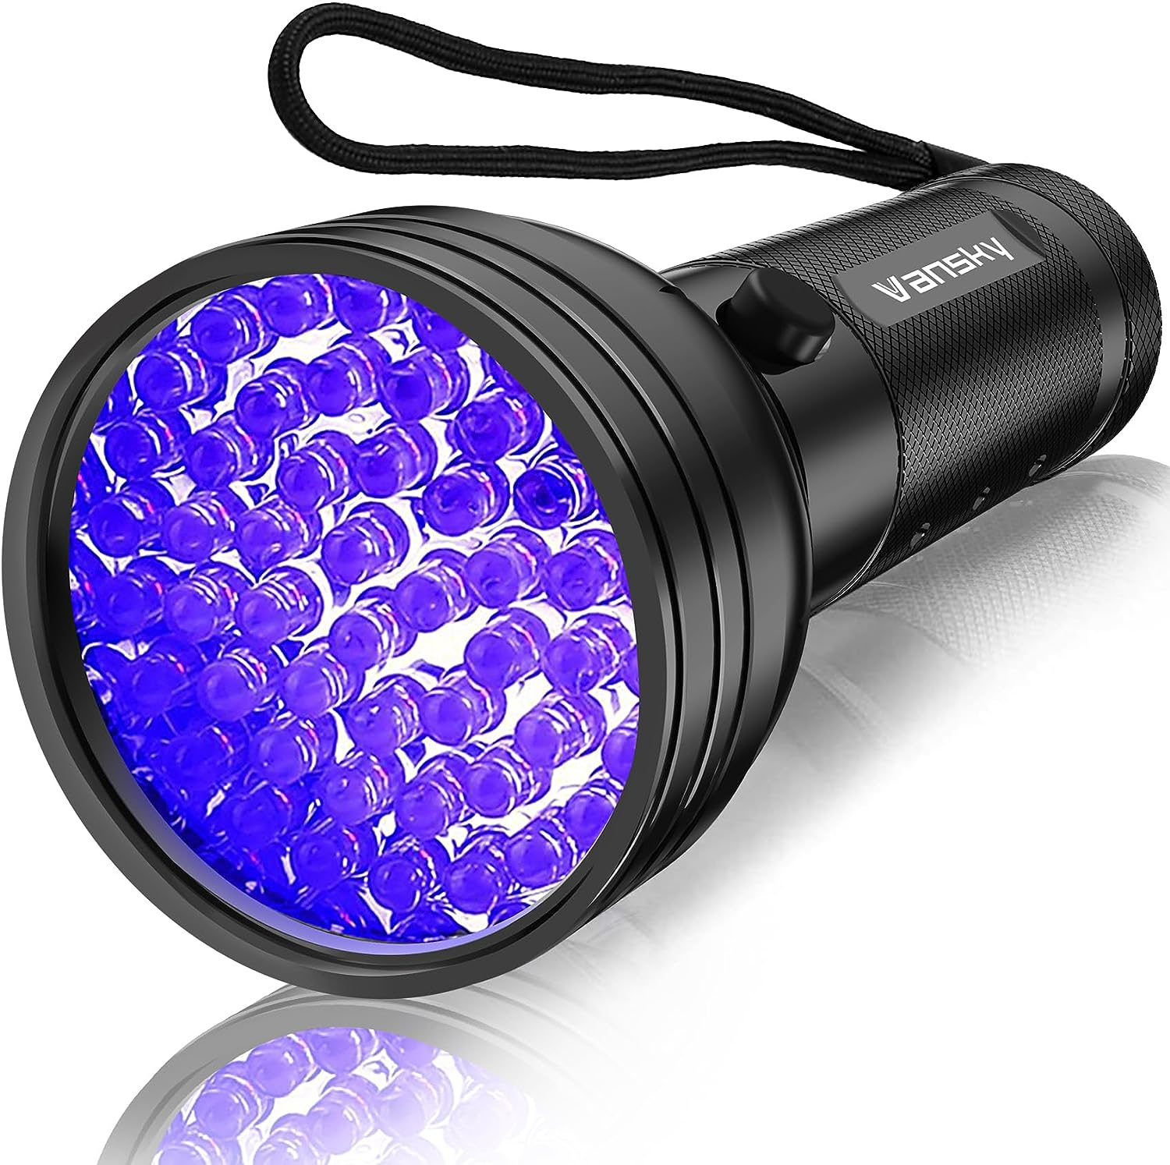
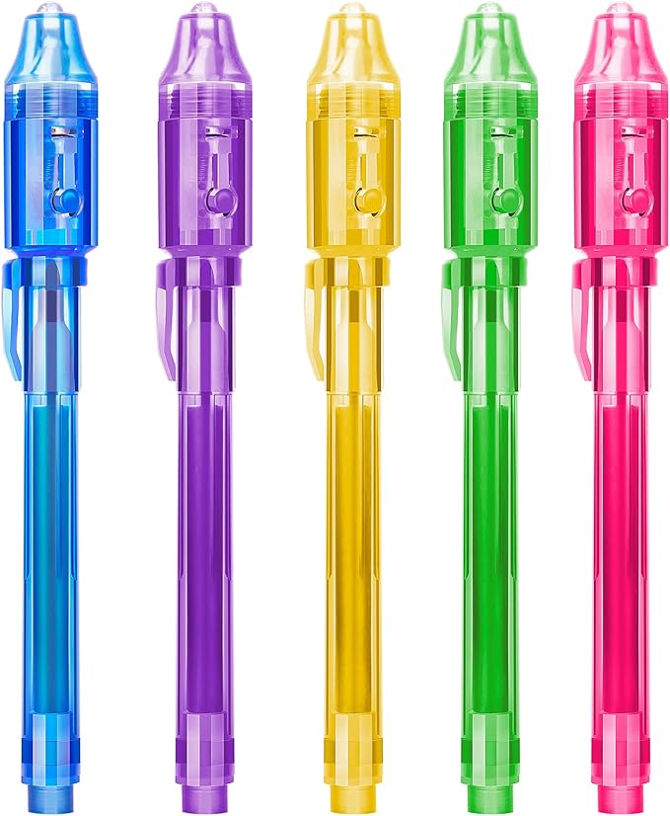
Blacklight and Invisible Ink
$10.79
https://www.amazon.com/Flashlight-Vansky-Ultraviolet-Blacklight-Eliminator/dp/B01A5KLUG2/ref=sr_1_2_sspa?crid=2JCU30E1598MK&keywords=black+light&qid=1706800216&sprefix=black+light%2Caps%2C106&sr=8-2-spons&sp_csd=d2lkZ2V0TmFtZT1zcF9hdGY&psc=1
$5.99
https://www.amazon.com/STENDA-Invisible-Blacklight-Christmas-Thanksgiving/dp/B08XW8L2NX/ref=sr_1_1_sspa?crid=2WBD8P0TZZ7ZE&keywords=invisible+ink+black+light+pen&qid=1706800421&sprefix=invisible+ink+black%2Caps%2C110&sr=8-1-spons&sp_csd=d2lkZ2V0TmFtZT1zcF9hdGY&psc=1

Slide 13
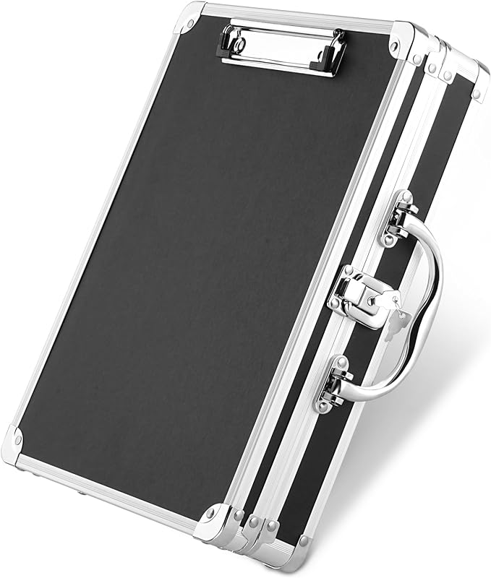
Briefcase
Price: $19.99
https://www.amazon.com/Sooez-Clipboard-Aluminum-Briefcase-Security/dp/B0BYJM64MD/ref=asc_df_B0BYJM64MD/?tag=hyprod-20&linkCode=df0&hvadid=673829519228&hvpos=&hvnetw=g&hvrand=17142575846900596586&hvpone=&hvptwo=&hvqmt=&hvdev=c&hvdvcmdl=&hvlocint=&hvlocphy=1025202&hvtargid=pla-2203875829130&mcid=e9323e055ad93acf934b1f55b9d5d48c&th=1

Slide 14
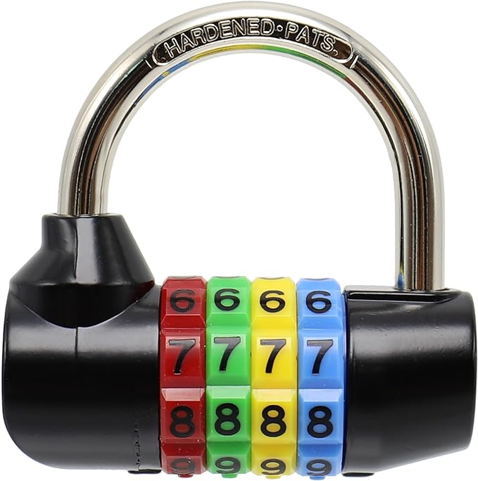
Color Lock
Price: $14.99
https://www.amazon.com/Bosvision-4-digit-Resettable-Combination-Luggage/dp/B00DFBWPY0/ref=asc_df_B00DFBWPY0/?tag=hyprod-20&linkCode=df0&hvadid=216708290339&hvpos=&hvnetw=g&hvrand=4120214248274868184&hvpone=&hvptwo=&hvqmt=&hvdev=c&hvdvcmdl=&hvlocint=&hvlocphy=9005925&hvtargid=pla-351741360218&mcid=533f69e5457438099ffa9e44c86e7ca0&gclid=CjwKCAiA_OetBhAtEiwAPTeQZwlmB7xLqcFTGH28JadI3WLGPotWBf8LCcSgjH9i499clihNTPYP3xoCuO0QAvD_BwE&th=1

Slide 15
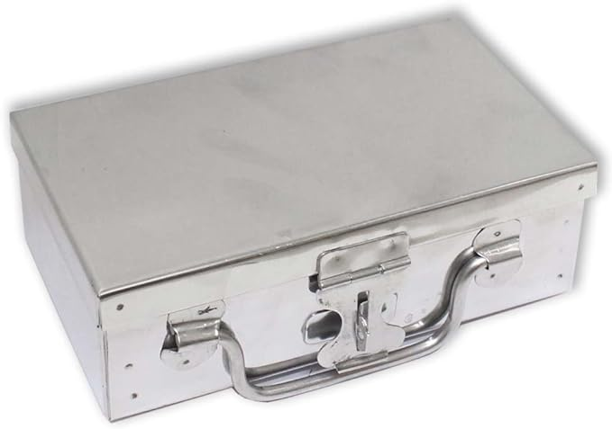
Lock Box
Price: $14.99
https://www.amazon.com/ToolUSA-Stainless-Steel-Security-Box/dp/B00VUG30GO/ref=sr_1_25?crid=2CL99GMNHCLJY&keywords=small%2Bbox%2Blockable&qid=1706800223&sprefix=small%2Bbox%2Blockabl%2Caps%2C81&sr=8-25&th=1

Slide 16
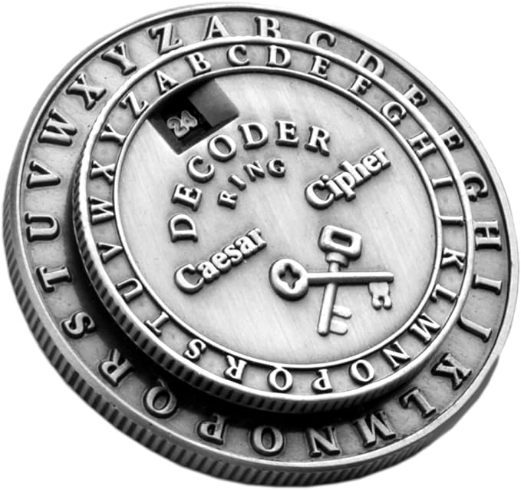
Caesar Cipher
Price: $19.99
https://www.amazon.com/Retroworks-Classic-Caesar-Medallion-Decoder/dp/B004D1L0B0/ref=asc_df_B004D1L0B0/?tag=hyprod-20&linkCode=df0&hvadid=238614861298&hvpos=&hvnetw=g&hvrand=12634065348717768728&hvpone=&hvptwo=&hvqmt=&hvdev=c&hvdvcmdl=&hvlocint=&hvlocphy=9005925&hvtargid=pla-392043781129&mcid=e3fa7d0f008a3aca9f9fbb372591b9bb&gclid=Cj0KCQiA2eKtBhDcARIsAEGTG403lGWU9uX4XxOGvo4tHjtKS4-F58nFH6ttWdGu9TQNQHSfuflIB_EaAiZ7EALw_wcB&th=1

